Slide 1

Information Communication & Technology
Teaching pupils’ at Bottesford Infants
Miss Tinker & Mrs Collins
March 2011

Slide 2
Agenda
Our technological world
What is ICT?
What will my child learn?
Why will my child learn this?
Why is the internet so important?
How to keep children safe on the computer
Time in the classroom
Notes:
Discuss ‘did u know’. How fast technology changing. World without mobiles, sat nav, sky, games consoles. What technology developments over the next decade?
Differences in the room – technological skills
Share data.
Show I phone clip. Imagine what this 2 year old can do with technology once they are at school.
Are u surprised what skills your child has developed already? Do you know what they can do/ skills they have?
ICT not all about technology

Slide 3
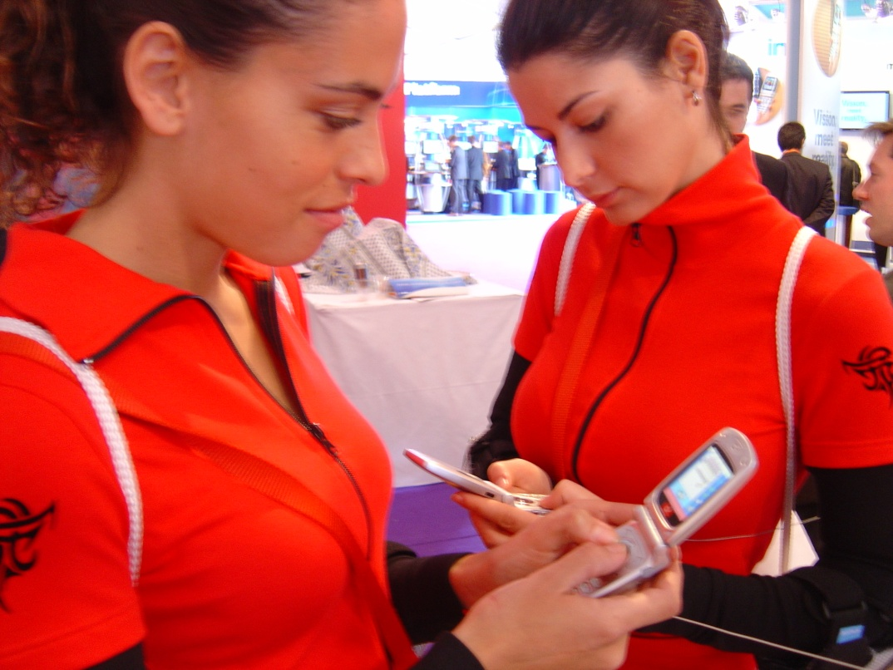
Anything that gets invented between then and before you turn thirty is incredibly exciting and creative and with any luck you can make a career out of it;
Notes:
Douglas Adams (author of Hitchhiker’s guide to the galaxy) wrote an essay ‘how to stop worrying and learn to love the internet’. He observed that our attitude to technology is determined by the age at which we first encounter it.

Slide 4
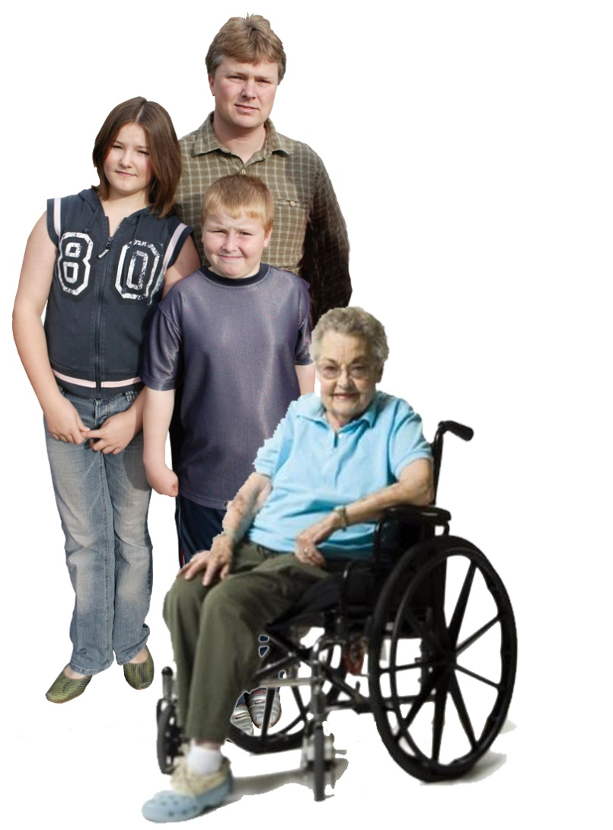
?
Anything that gets invented after you’re thirty is against the natural order of things and the beginning of the end of civilisation as we know it …until it’s been around for about ten years when it gradually turns out to be alright really.”
Douglas Adams
Notes:
Is this a behaviour u recognise? In yourself? Grandparents?
Example mobile phones?

Slide 5
Aim:
“Helping to make the internet a great and safe place for children”
Promote the positive
Respond to the negative

Slide 6
Benefits of the internet
Educational games and programmes
Research information
The opportunity to communicate with people from all around the world
The opportunity to share resources and ideas with people that have the same interests
Shopping around the world without leaving your computer
Notes:
Parents use for e-mail or web research
Young people – interactive chat, IM, music, games, blog
Adults mostly download and young people upload (contribute to info online)
Internet now more interactive and personal. E.g. Newspaper interact podcasts, blog etc
Discover, connect & create

Slide 7
Risks of using the internet
Paedophiles use the internet to meet young people
People lying to others online
Bullying using the internet (Cyberbulling)
Seeing inappropriate images and material
Viruses and pop ups
Notes:
Signing up for things –commercial risks
Cyberbulling – harassment, peer communication/exclusions, manipulation, threats. Can have bigger impact – bigger audience. Easier for coward

Slide 8

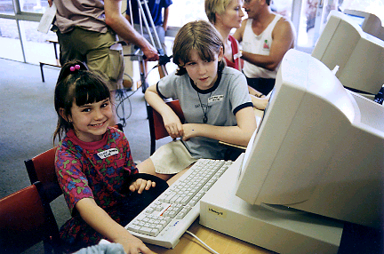
Knowledge vs. Wisdom
KNOWLEDGE
Many children pick up technology quicker!
WISDOM
Understanding how to behave in a virtual world
Notes:
Must transfer offline wisdom into the online world
Don’t need instruction manual
Ensure use safely and responsibily
Make safe descisons

Slide 9
SMART RULES
Safe
Meeting
Accepting
Reliable
Tell
Notes:
Keep safe by being careful not to give out personal information when you’re chatting or posting online. Personal information includes your email address,
(Accepting emails, IM messages, or opening files, pictures or texts from people you don’t know or trust can lead to problems – they may contain viruses or nasty messages!)phone number and password).
(Meeting someone you have only been in touch with online can be dangerous. Only do so with your parents’ or carers’ permission and even then only when they can be present. Remember online friends are still strangers even if you have been talking to them for a long time).
Not everything is true. (Someone online might lie about who they are and information on the internet may not be true. Always check information with other websites, books or someone who knows. If you like chatting online it’s best to only chat to your real world friends and family)
(Tell your parent, carer or a trusted adult if someone or something makes you feel uncomfortable or worried, or if you or someone you know is being bullied online).

Slide 10

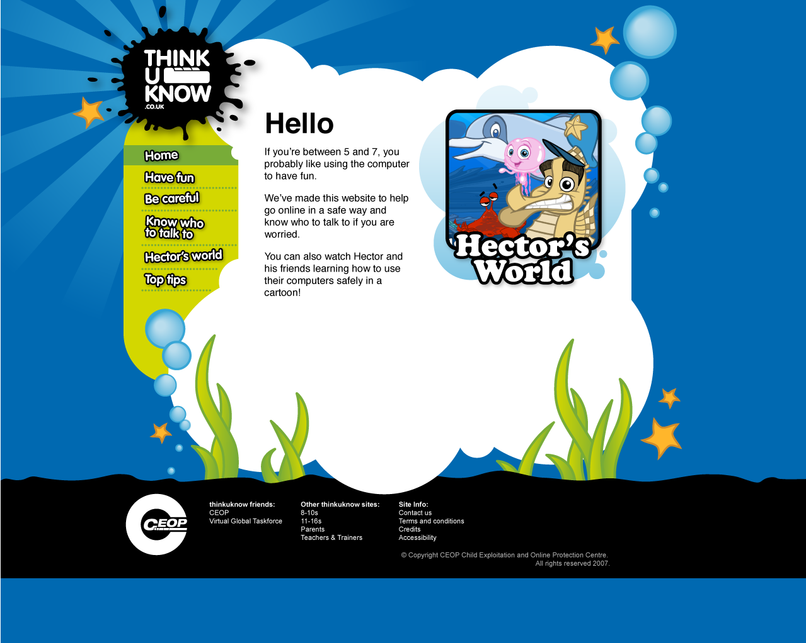
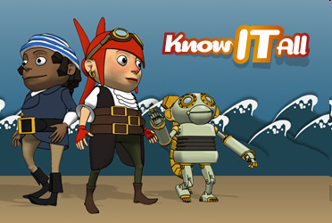
What we teach our pupils...
Lee & Kims’ adventures – animal magic
The Adventures of Kara, Winston and the SMART Crew

Slide 11
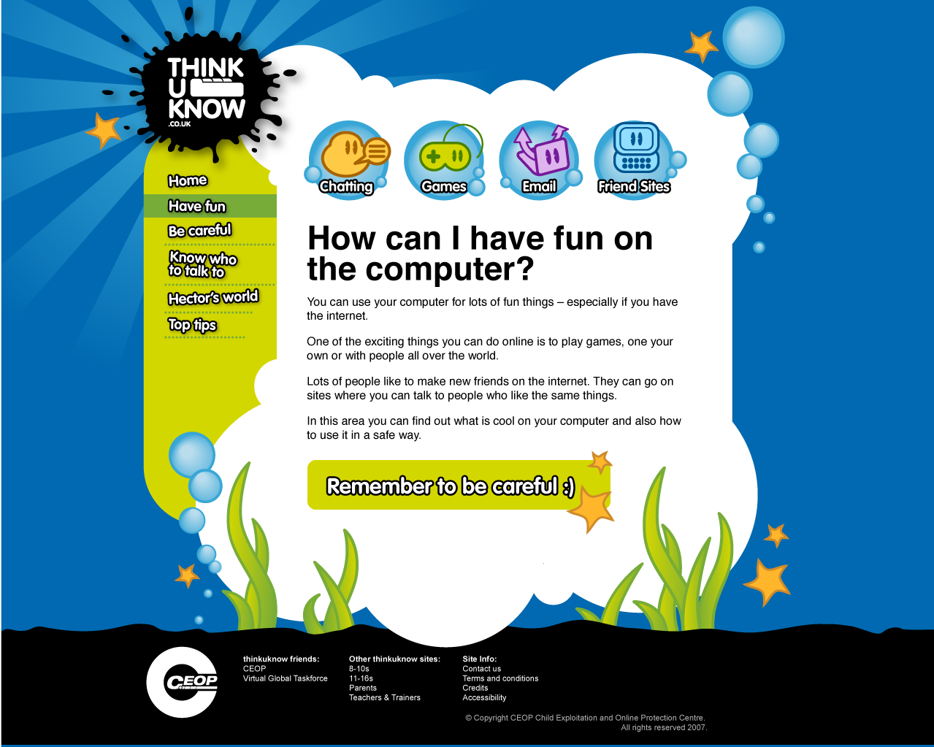

Slide 12
Create a PACT with your child
Private information – teach them what this is and why it is important to keep this personal
A central place – keep your PC in an open place in the house
Communication – talk to your child about what they are doing on the computer
Teach yourself- consider using the same technology as your child
USE PARENTAL CONTROL TOOLS!

Slide 13
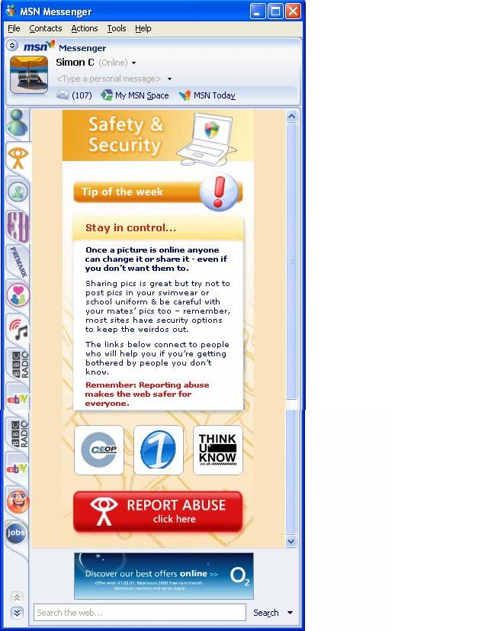
Report Abuse’ in action
Microsoft have made a real commitment

Slide 14
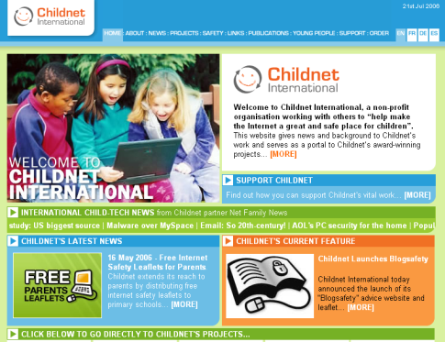






More resources…
www.childnet.com
www.kidsmart.org.uk
www.digizen.org
www.bbc.co.uk/cbbc/help/web/besmart.shtml

